Slide 1

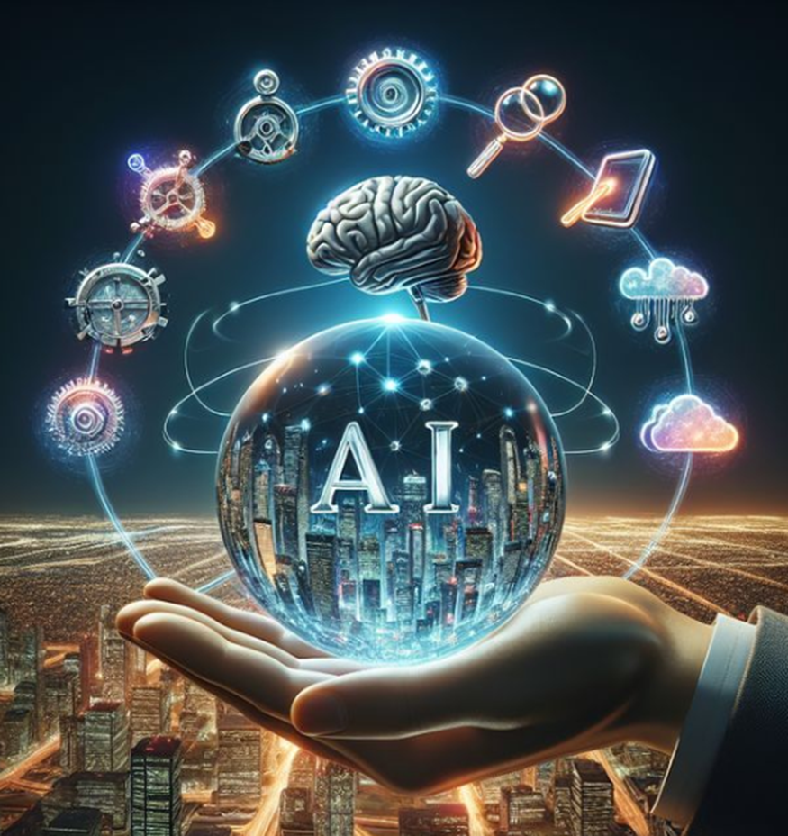
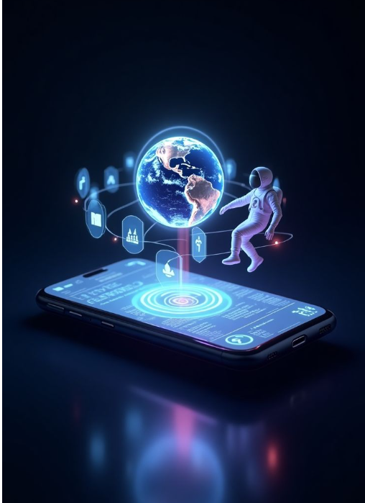

Delhi Public School, Ranipur welcomes you to Technovation 3.0 Date – 23rd August 2025 Venue – Computer Lab, Senior Wing
Innovation is the ability to see change as an opportunity — not a threat."
— Steve Jobs
"AI will not replace humans. But humans with AI will replace humans without AI."
— Unknown
“Code the Future, Connect the World!”
"Any sufficiently advanced technology is indistinguishable from magic." — Arthur C. Clarke

Slide 2
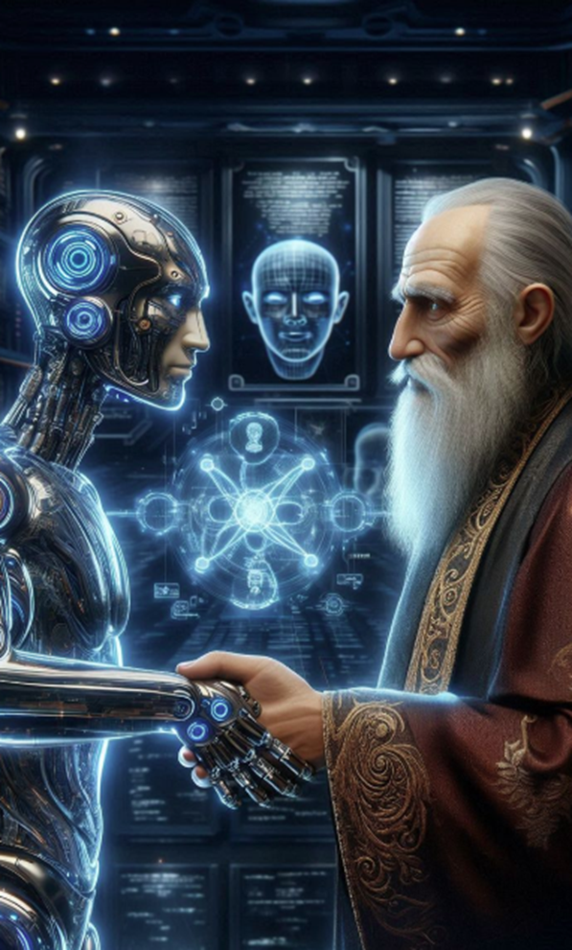
Delhi Public School, Ranipur welcomes you to Technovation 3.0 Date – 23rd August 2025 Venue – Computer Lab, Senior Wing
“Code the Future, Connect the World!”
"AI will not replace humans. But humans with AI will replace humans without AI."
— Unknown
"The coming era of AI is not one of man versus machine, but rather of man with machine."
— Satya Nadella
"Any sufficiently advanced technology is indistinguishable from magic." — Arthur C. Clarke

Slide 3

Delhi Public School, Ranipur welcomes you to Technovation 3.0 Date – 23rd August 2025 Venue – Computer Lab, Senior Wing
“Code the Future, Connect the World!”
"AI will not replace humans. But humans with AI will replace humans without AI."
— Unknown
"The coming era of AI is not one of man versus machine, but rather of man with machine."
— Satya Nadella
"Any sufficiently advanced technology is indistinguishable from magic." — Arthur C. Clarke

Slide 4
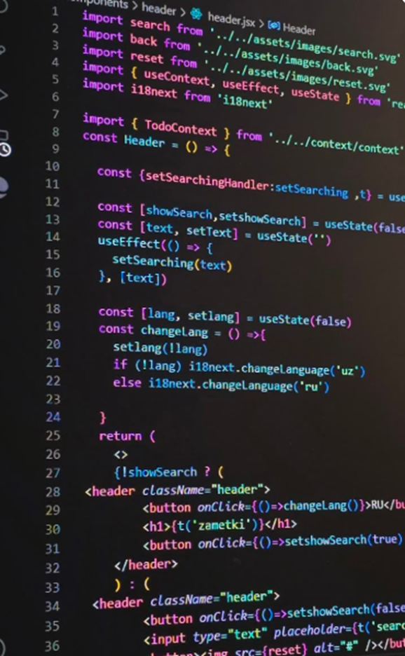
Delhi Public School, Ranipur welcomes you to Technovation 3.0 Date – 23rd August 2025 Venue – Computer Lab, Senior Wing
"The coming era of AI is not one of man versus machine, but rather of man with machine."
— Satya Nadella
“Code the Future, Connect the World!”
"Debugging is twice as hard as writing the code in the first place."
— Brian Kernighan
"Any sufficiently advanced technology is indistinguishable from magic." — Arthur C. Clarke

Slide 5

Delhi Public School, Ranipur welcomes you to Technovation 3.0 Date – 23rd August 2025 Venue – Computer Lab, Senior Wing
"The Internet is becoming the town square for the global village of tomorrow."
— Bill Gates
“Code the Future, Connect the World!”
"Debugging is twice as hard as writing the code in the first place."
— Brian Kernighan
"Any sufficiently advanced technology is indistinguishable from magic." — Arthur C. Clarke

Slide 6
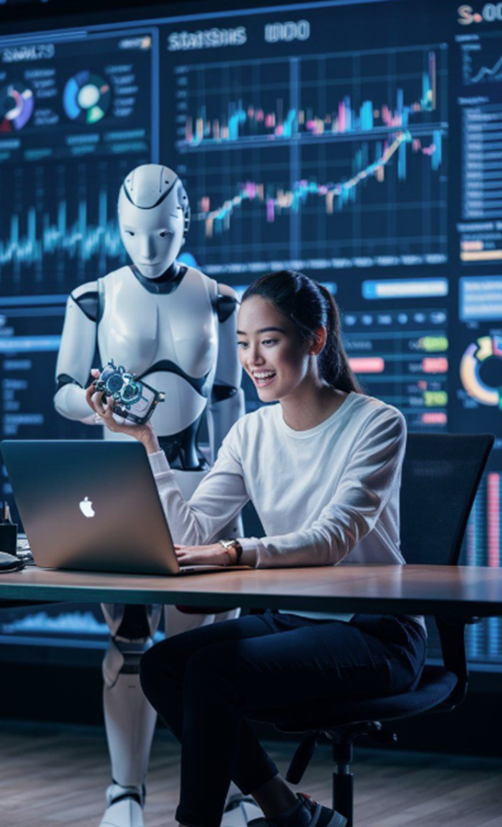
Delhi Public School, Ranipur welcomes you to Technovation 3.0 Date – 23rd August 2025 Venue – Computer Lab, Senior Wing
“Code the Future, Connect the World!”
"The Internet is becoming the town square for the global village of tomorrow."
— Bill Gates
"The Web does not just connect machines, it connects people."
— Tim Berners-Lee
"Debugging is twice as hard as writing the code in the first place."
— Brian Kernighan

Slide 7
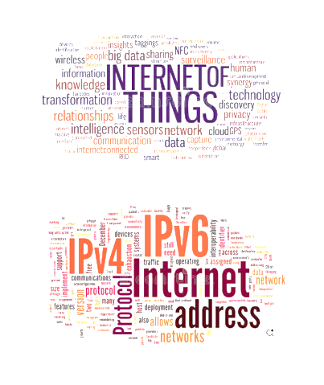
Delhi Public School, Ranipur welcomes you to Technovation 3.0 Date – 23rd August 2025 Venue – Computer Lab, Senior Wing
“Code the Future, Connect the World!”
"The Internet is becoming the town square for the global village of tomorrow."
— Bill Gates
"The Web does not just connect machines, it connects people."
— Tim Berners-Lee
"The great thing about the Internet is that it’s open. The bad thing is that it’s open."
— Esther Dyson

Slide 8
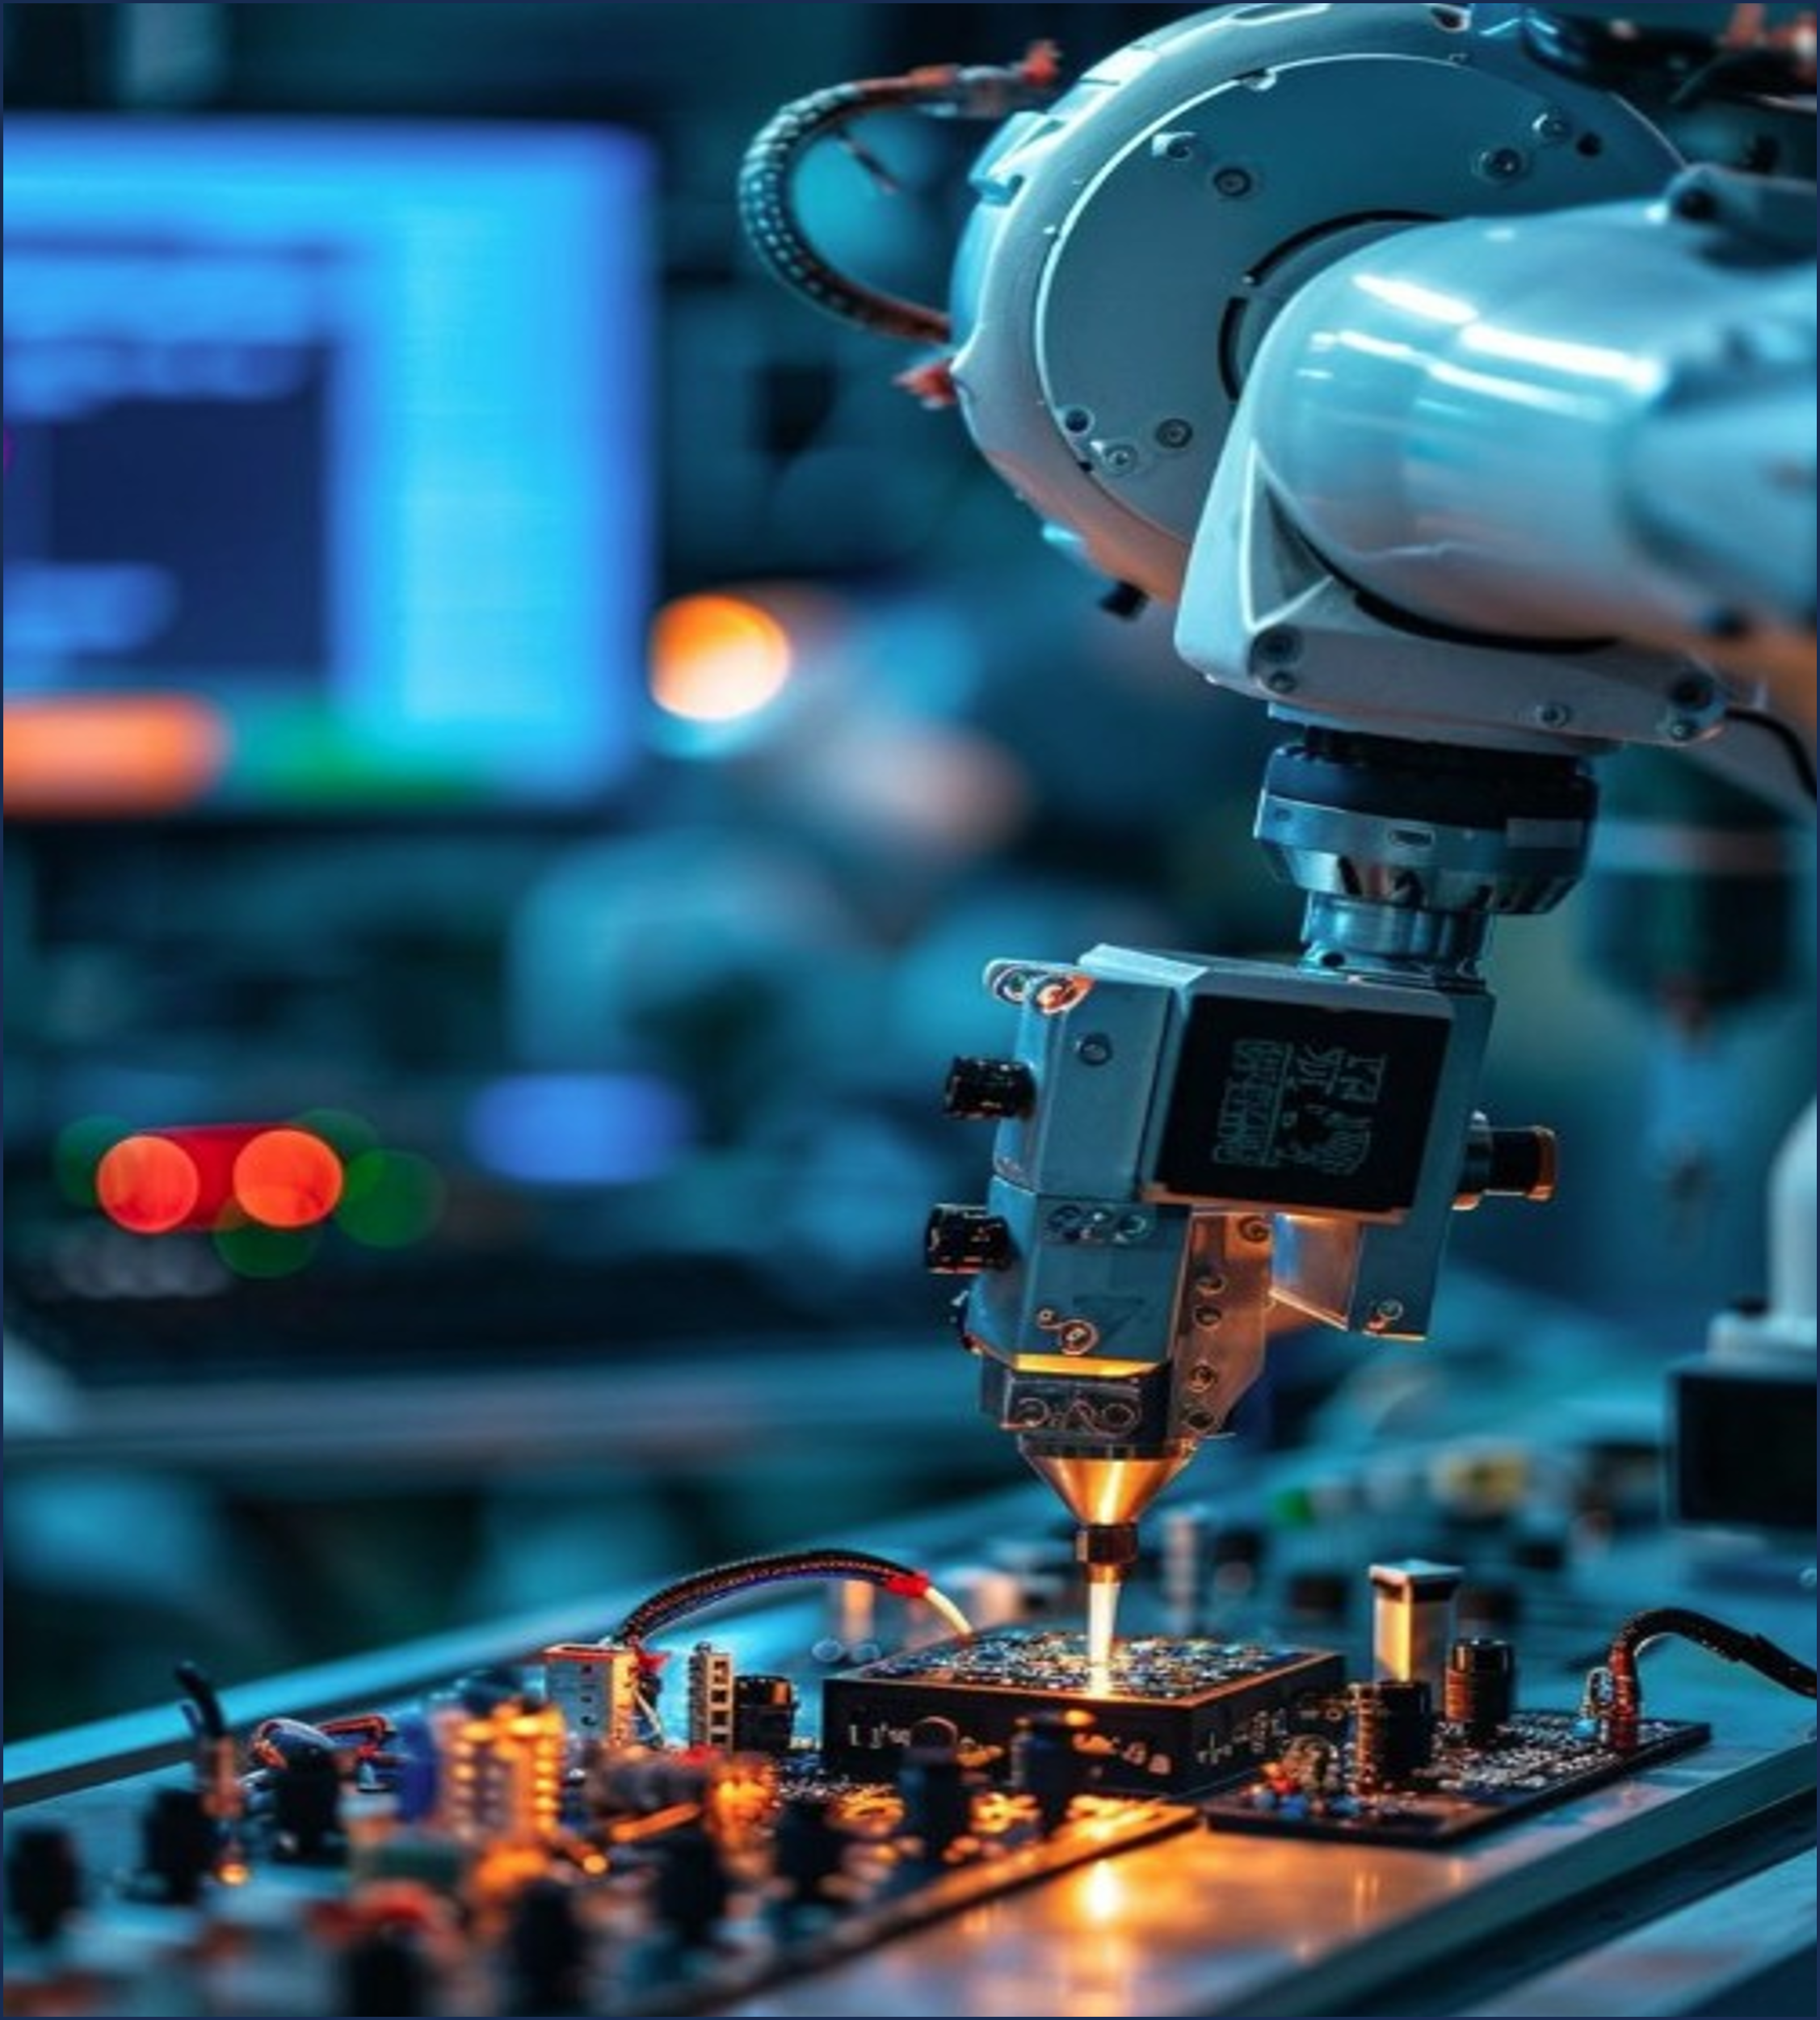
Delhi Public School, Ranipur welcomes you to Technovation 3.0 Date – 23rd August 2025 Venue – Computer Lab, Senior Wing
"The Web does not just connect machines, it connects people."
— Tim Berners-Lee
"The great thing about the Internet is that it’s open. The bad thing is that it’s open."
— Esther Dyson
"Design is not just what it looks like and feels like. Design is how it works."
— Steve Jobs
“Code the Future, Connect the World!”

Slide 9
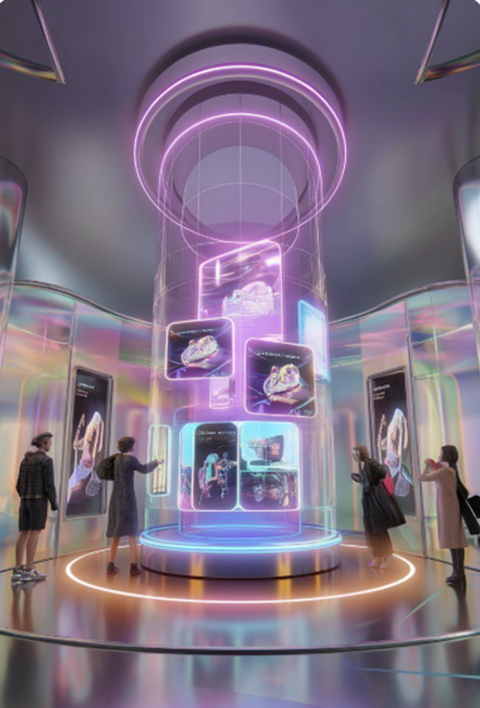
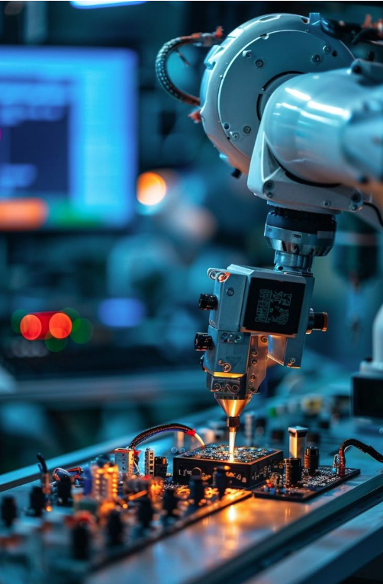
Delhi Public School, Ranipur welcomes you to Technovation 3.0 Date – 23rd August 2025 Venue – Computer Lab, Senior Wing
"If you're not embarrassed by the first version of your product, you’ve launched too late."
— Reid Hoffman
"The great thing about the Internet is that it’s open. The bad thing is that it’s open."
— Esther Dyson
"Design is not just what it looks like and feels like. Design is how it works."
— Steve Jobs
“Code the Future, Connect the World!”

Slide 10
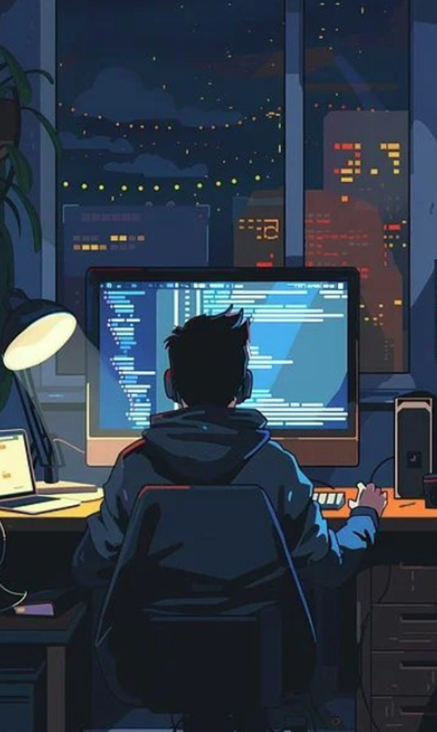
Delhi Public School, Ranipur welcomes you to Technovation 3.0 Date – 23rd August 2025 Venue – Computer Lab, Senior Wing
"If you're not embarrassed by the first version of your product, you’ve launched too late."
— Reid Hoffman
“Code the Future, Connect the World!”
"The most dangerous phrase in software development: 'We’ve always done it this way.'"
— Grace Hopper
"Design is not just what it looks like and feels like. Design is how it works."
— Steve Jobs

Slide 11

Delhi Public School, Ranipur welcomes you to Technovation 3.0 Date – 23rd August 2025 Venue – Computer Lab, Senior Wing
"If you're not embarrassed by the first version of your product, you’ve launched too late."
— Reid Hoffman
“Code the Future, Connect the World!”
"The most dangerous phrase in software development: 'We’ve always done it this way.'"
— Grace Hopper
"Good software, like wine, takes time."
— Joel Spolsky

Slide 12
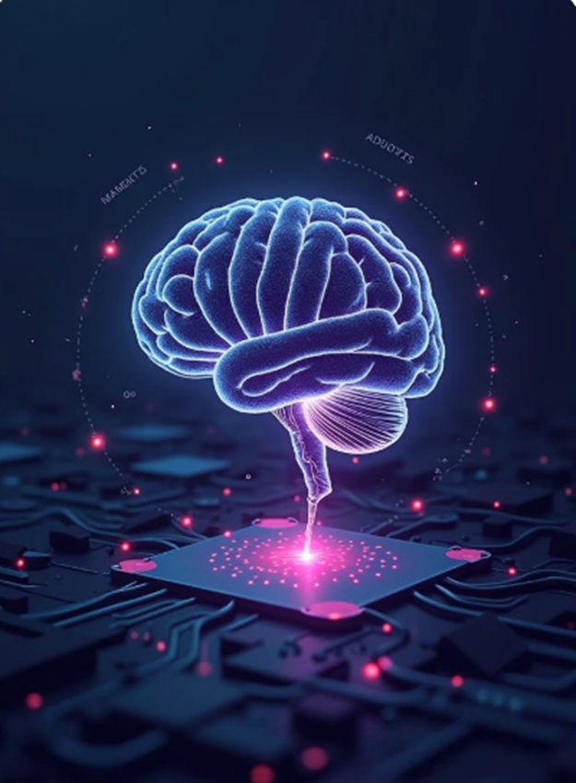
Delhi Public School, Ranipur welcomes you to Technovation 3.0 Date – 23rd August 2025 Venue – Computer Lab, Senior Wing
"The most dangerous phrase in software development: 'We’ve always done it this way.'"
— Grace Hopper
"Good software, like wine, takes time."
— Joel Spolsky
“Code the Future, Connect the World!”
"It’s not about ideas. It’s about making ideas happen."
— Scott Belsky

Slide 13
Delhi Public School, Ranipur welcomes you to Technovation 3.0 Date – 23rd August 2025 Venue – Computer Lab, Senior Wing
"Good software, like wine, takes time."
— Joel Spolsky
“Code the Future, Connect the World!”
"It’s not about ideas. It’s about making ideas happen."
— Scott Belsky
Innovation is the ability to see change as an opportunity — not a threat."
— Steve Jobs

Slide 14
Delhi Public School, Ranipur welcomes you to Technovation 3.0 Date – 23rd August 2025 Venue – Computer Lab, Senior Wing
"It’s not about ideas. It’s about making ideas happen."
— Scott Belsky
Innovation is the ability to see change as an opportunity — not a threat."
— Steve Jobs
“Code the Future, Connect the World!”
"Any sufficiently advanced technology is indistinguishable from magic." — Arthur C. Clarke

